Slide 1
Purine Metabolism Network Broad Overview
Slides are oriented to examine differences when going from one slide to the next so several slides are used more than once

Slide 2
Female G85R vs WT Control and TKT-Df

Slide 3
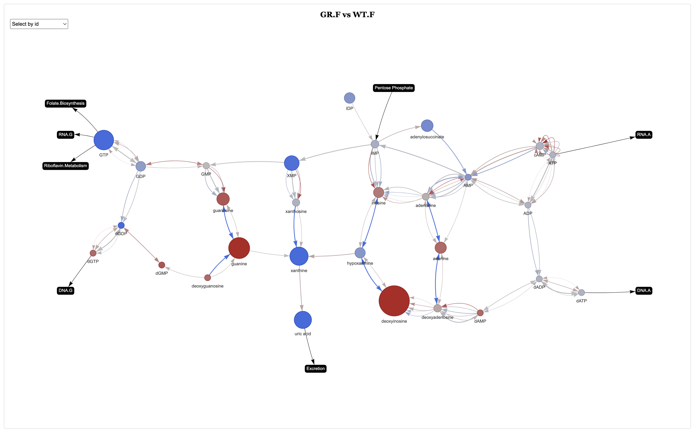

Slide 4
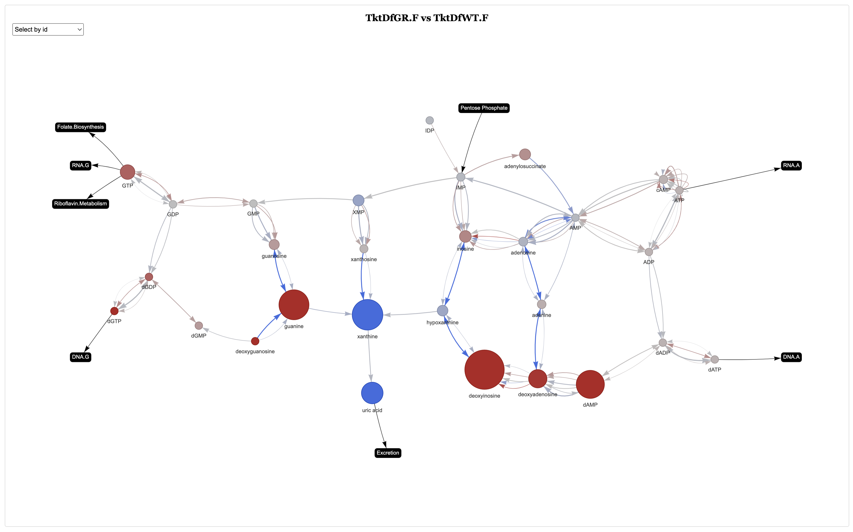

Slide 5
Female G85R vs WT Control and TKT-OE

Slide 7
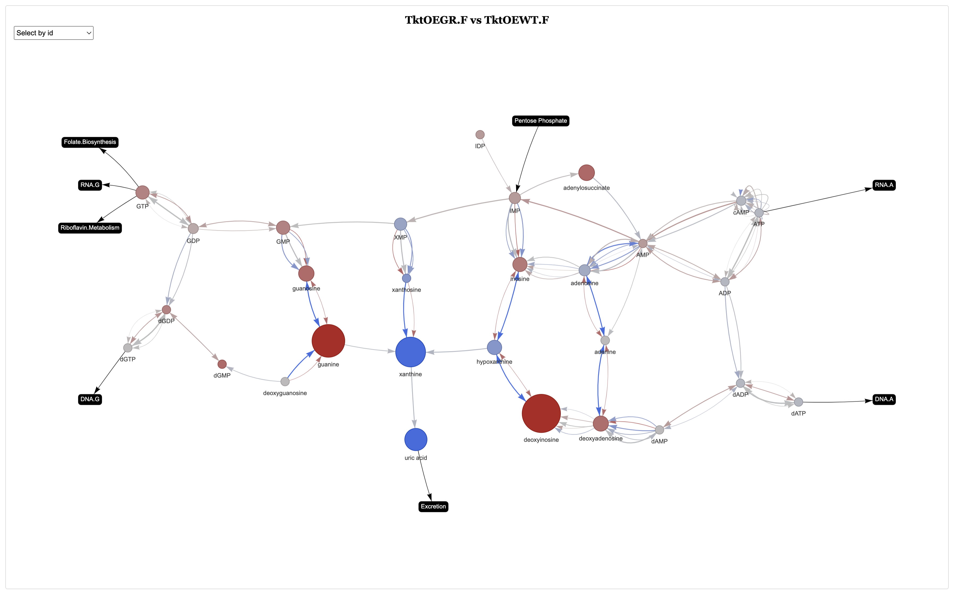

Slide 8
Male G85R vs WT Control and TKT-Df

Slide 9
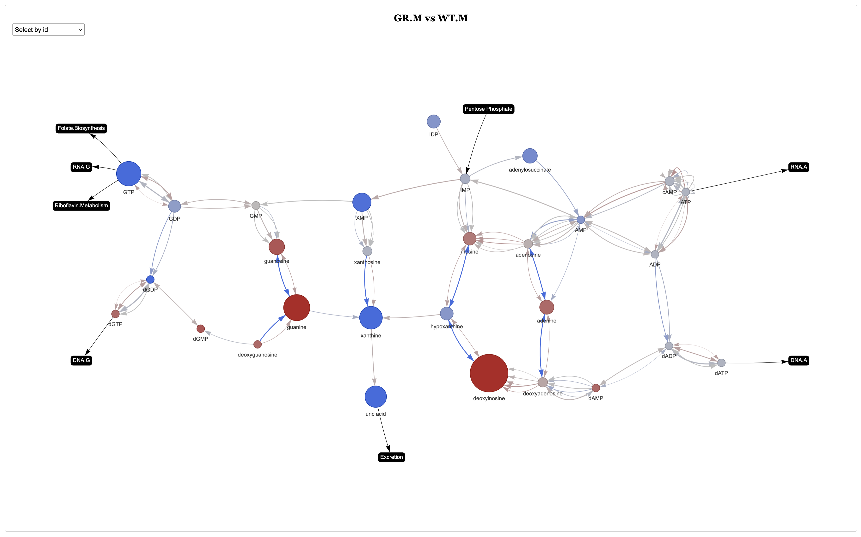

Slide 10
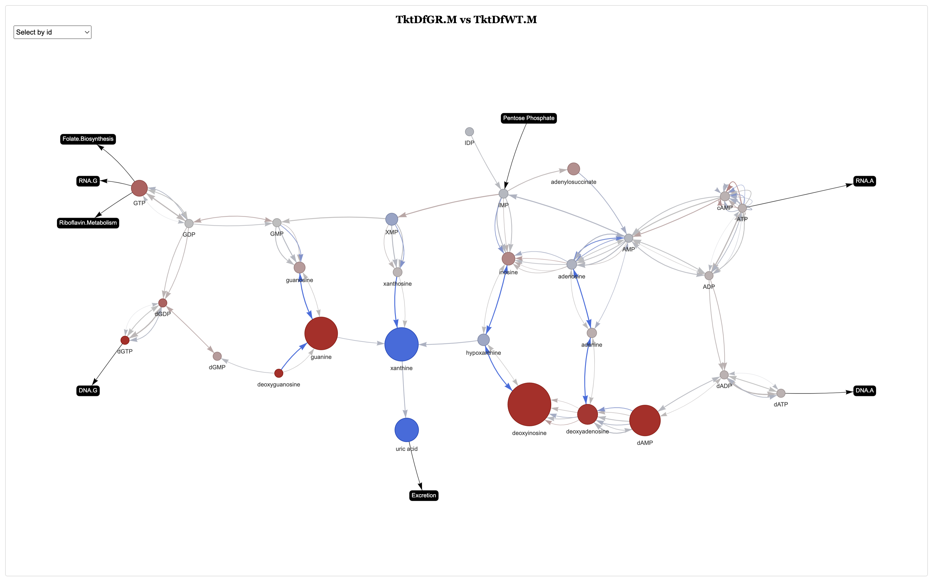

Slide 11
Male G85R vs WT Control and TKT-OE

Slide 13
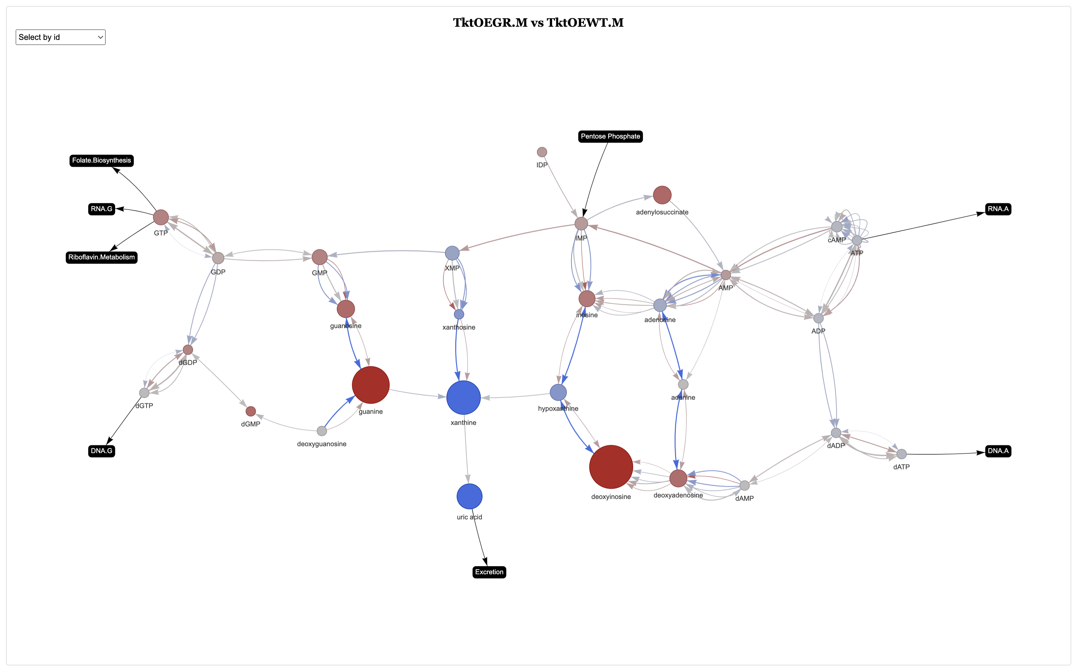

Slide 14
Female TKT-Df Response
GR vs WT Control
GR Control vs TKT-Df
WT Control vs TKT-Df
GR vs WT TKT-Df

Slide 16
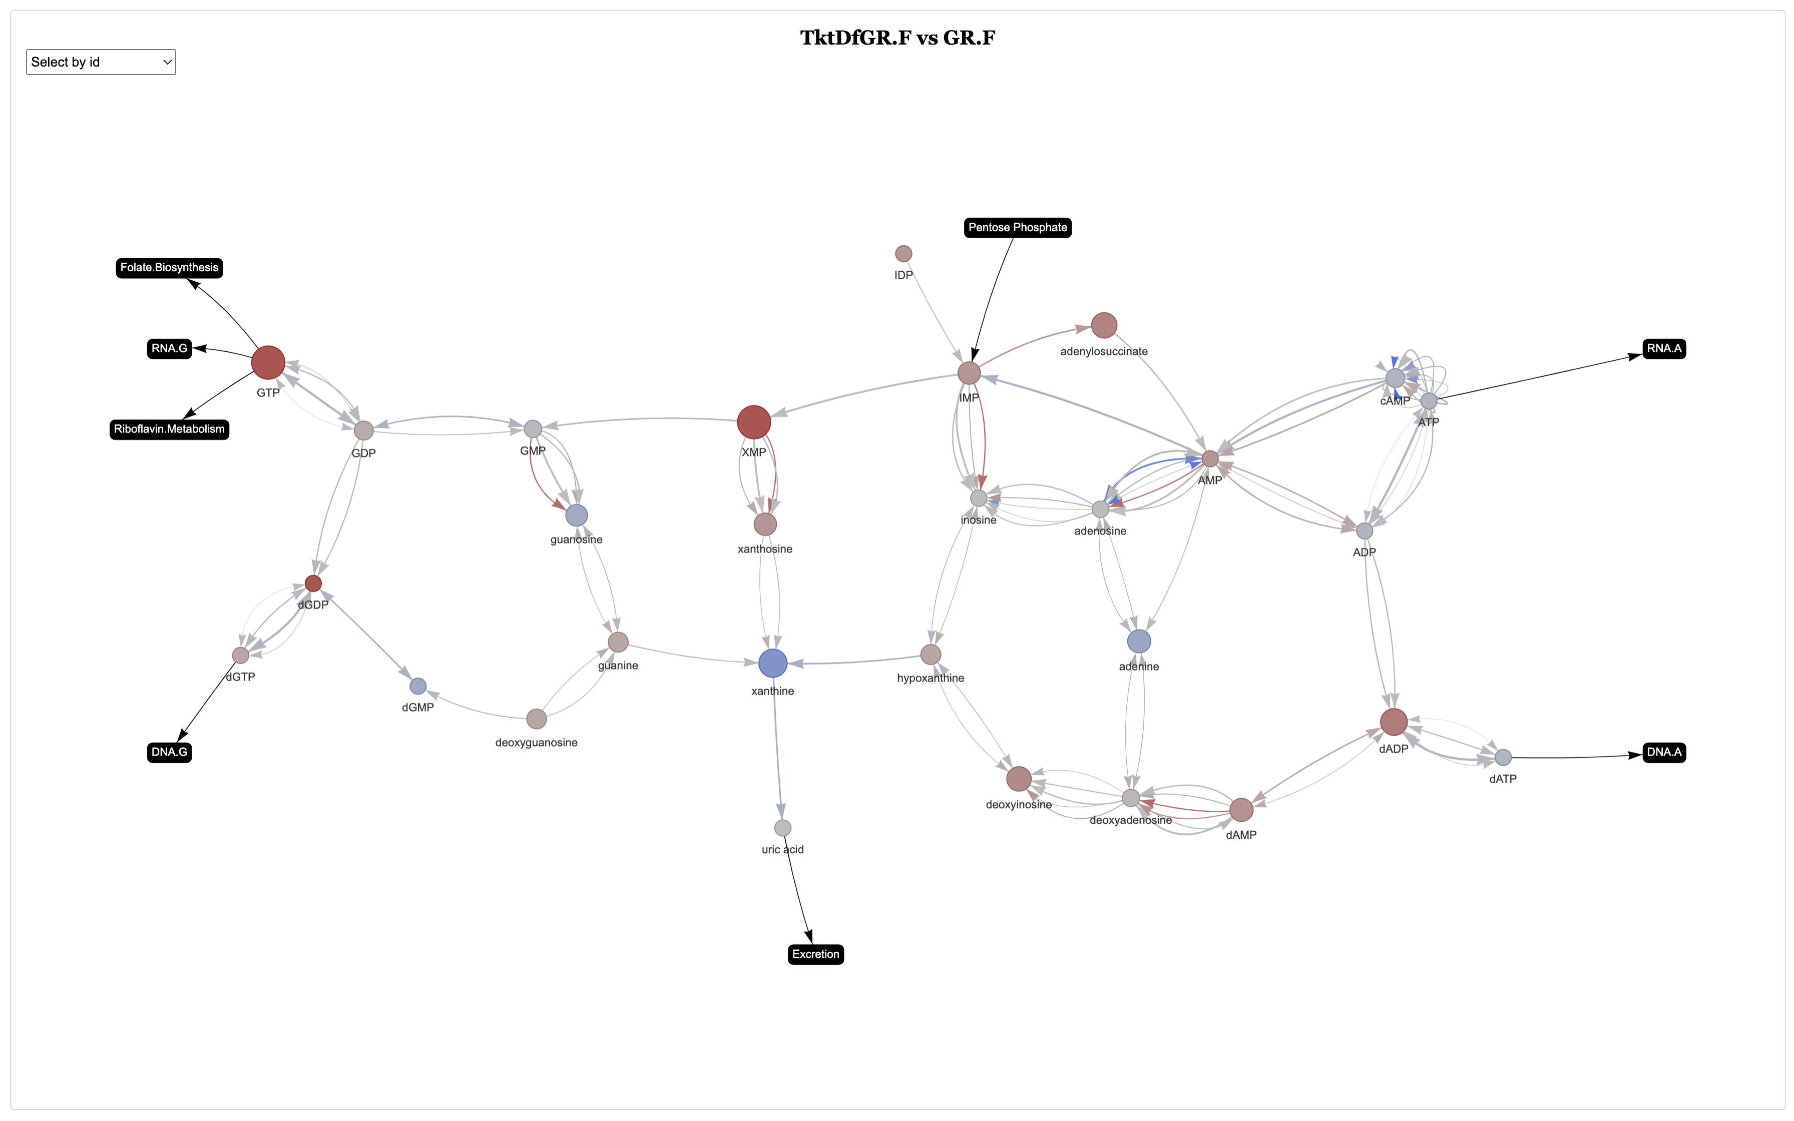

Slide 17
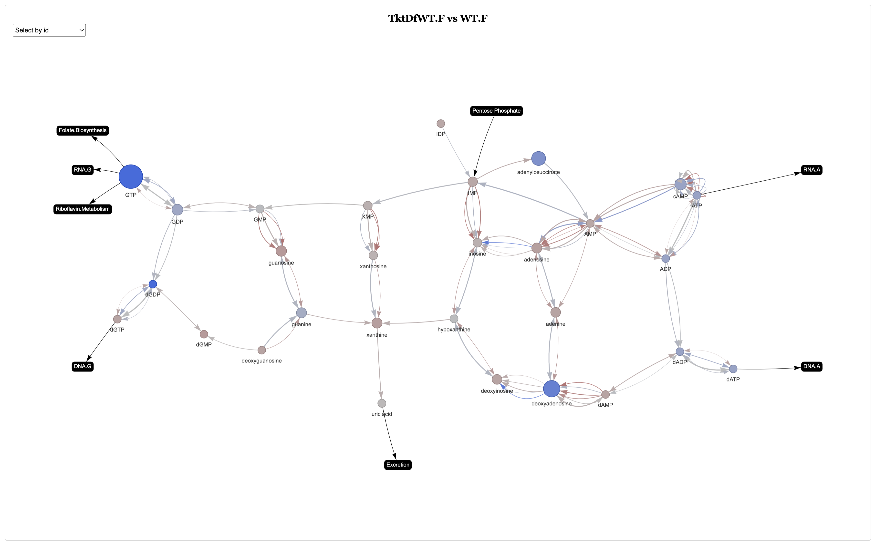

Slide 19
Male TKT-Df Response
GR vs WT Control
GR Control vs TKT-Df
WT Control vs TKT-Df
GR vs WT TKT-Df

Slide 21
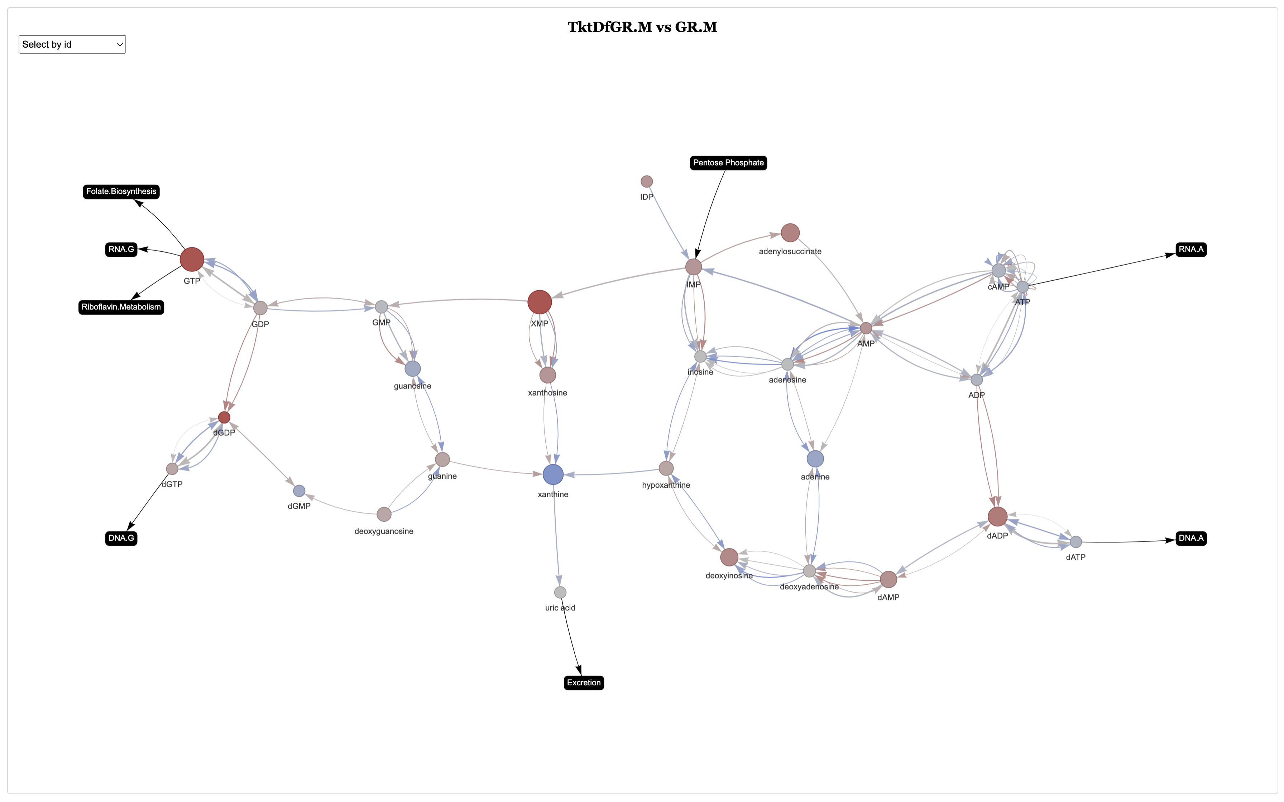

Slide 22
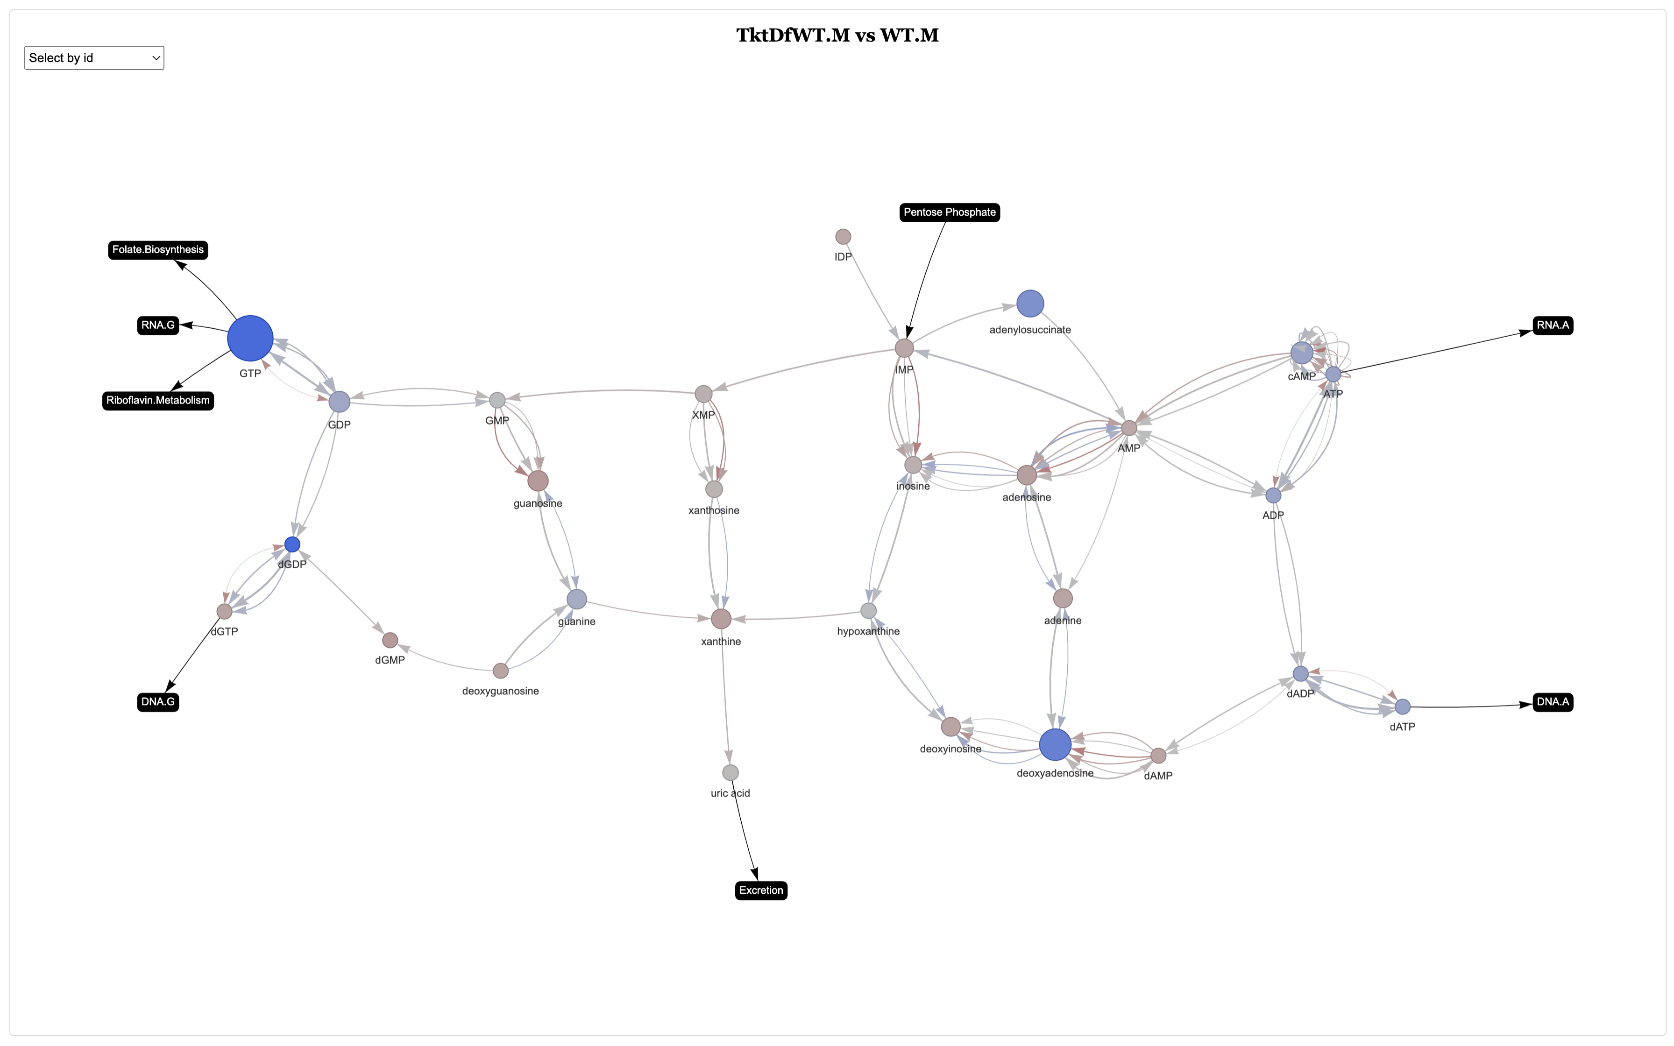

Slide 24
Female TKT-OE Response
GR vs WT Control
GR Control vs TKT-OE
WT Control vs TKT-OE
GR vs WT TKT-OE

Slide 26
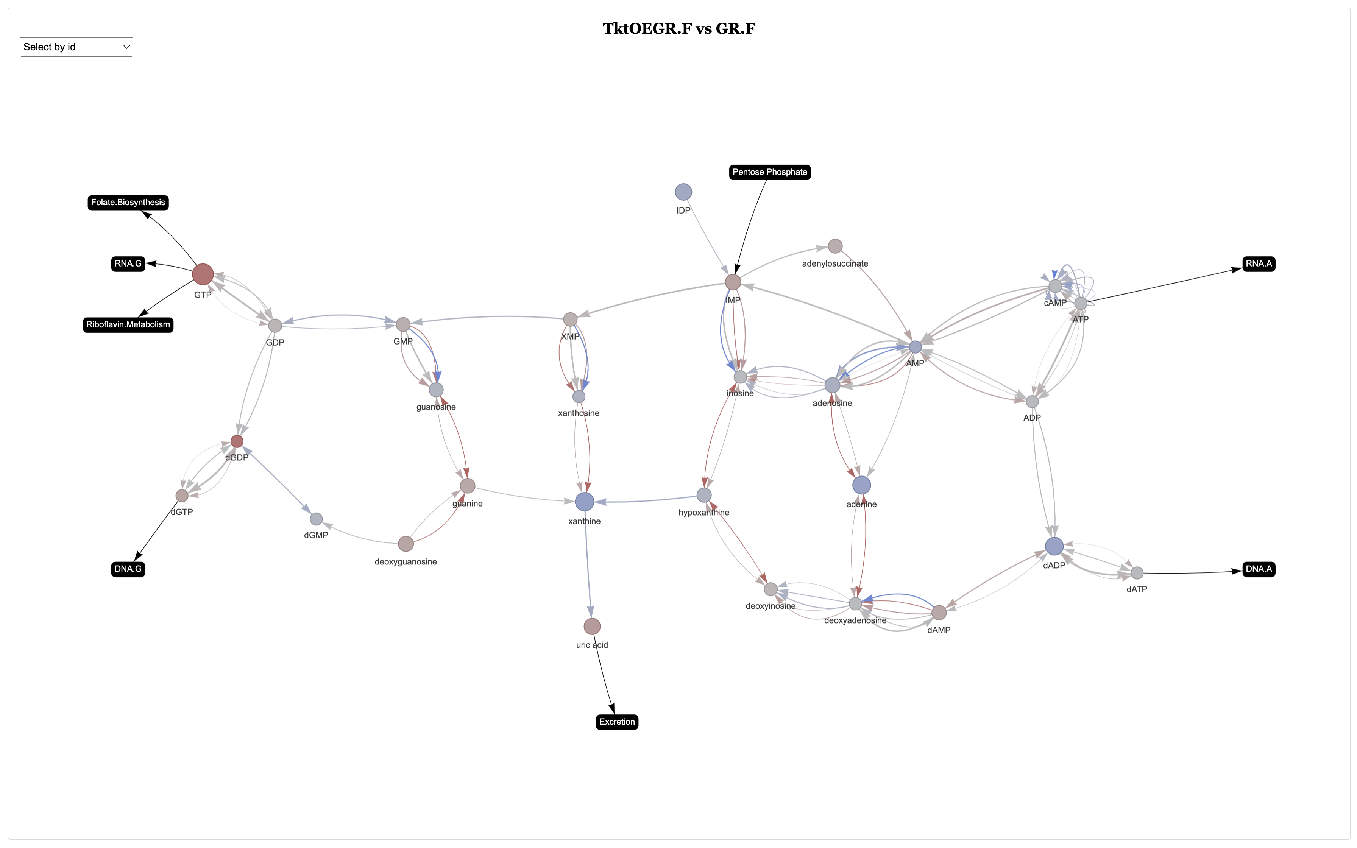

Slide 27
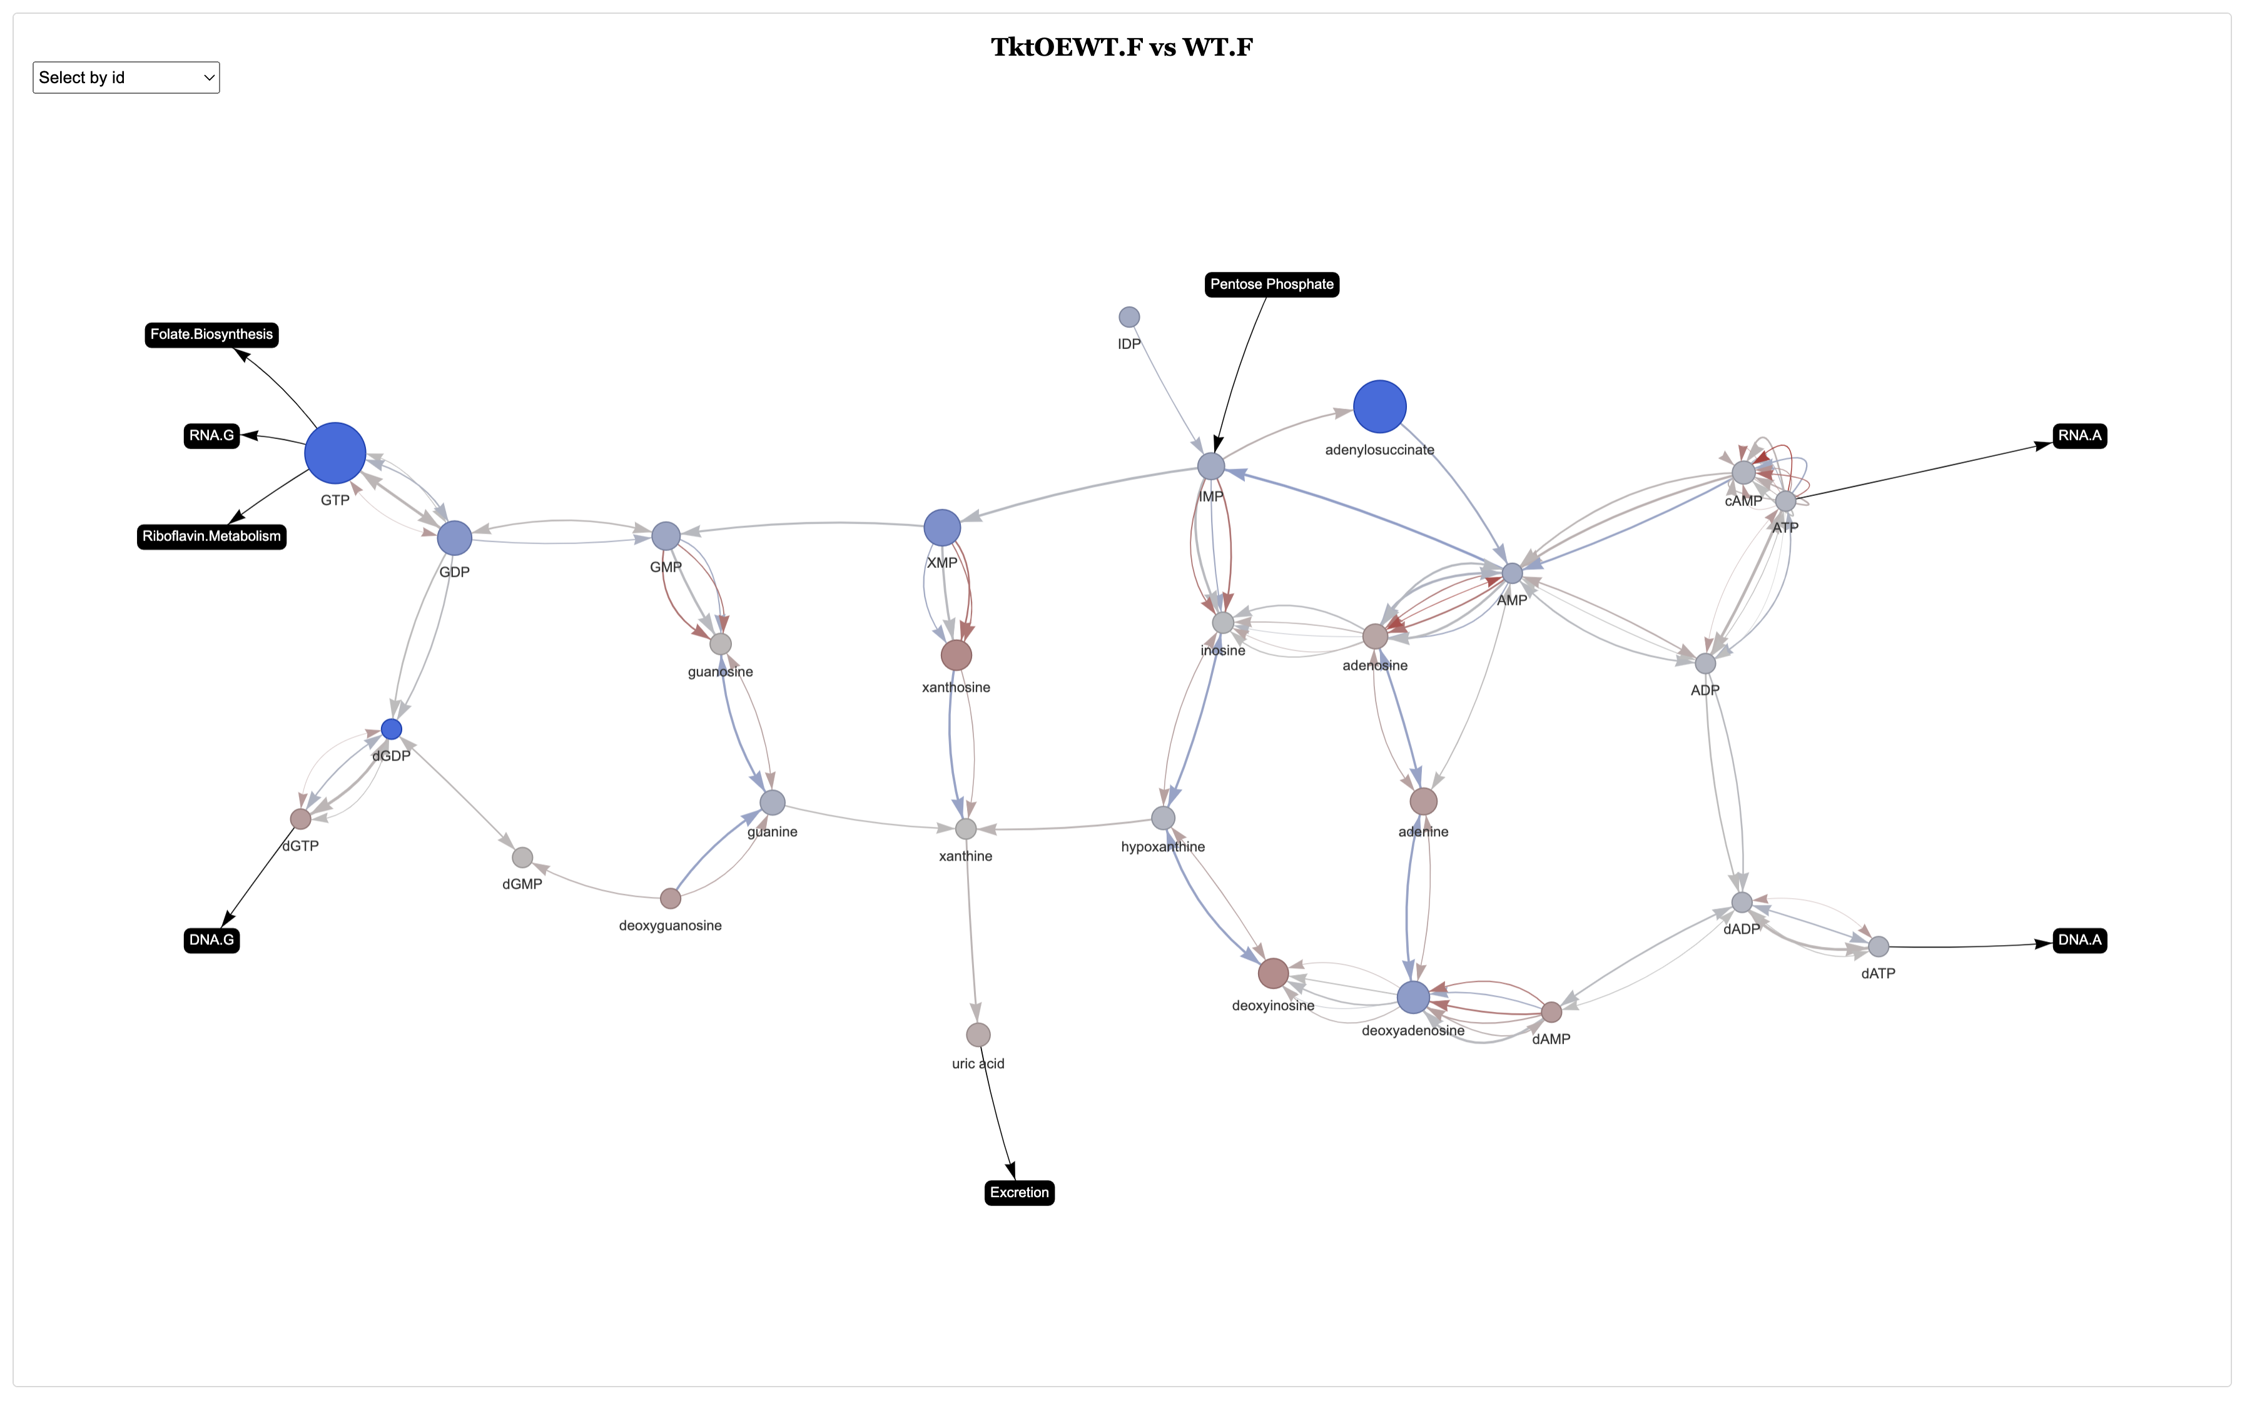

Slide 29
Male TKT-OE Response
GR vs WT Control
GR Control vs TKT-OE
WT Control vs TKT-OE
GR vs WT TKT-OE

Slide 31
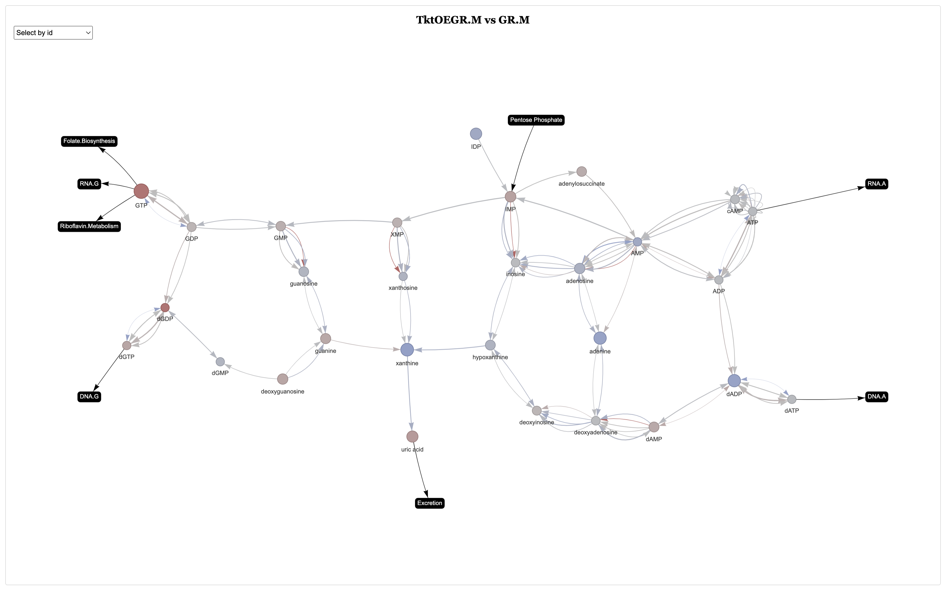

Slide 32
